Slide 1
Waves
Waves is vibrations or oscillations which-
Transfers energy
Usually involves a periodic, repetitive Movement.
Does not result in a net movement of the medium or particles in the medium (mechanical wave).
So we may say-”A wave is a disturbance in a medium (Mechanical) that carries energy without a net movement of particles. It may take the form of elastic deformation, a variation of pressure, electric or magnetic intensity, electric potential, or temperature”.

Slide 2
Waves
Types of Waves:
The types of waves are given below.
Transverse Waves: Waves in which the medium moves at right angles to the direction of the wave.
Examples of transverse waves:
Water waves (ripples of gravity waves, not sound through water)
Light waves
S-wave earthquake waves
Stringed instruments
Torsion wave
The high point of a transverse wave is a crest. The low part is a trough.

Slide 3
Waves
Longitudinal Wave:A longitudinal wave has the movement of the particles in the medium in the same dimension as the direction of movement of the wave.
Examples of longitudinal waves:
Sound waves
P-type earthquake waves
Compression wave
Parts of longitudinal waves:
Compression: where the particles are close together.
Rarefaction: where the particles are spread apart.

Slide 4
Waves
Electromagnetic Waves:
These waves are the disturbance that does not need any object medium for propagation and can easily travel through the vacuum. They are produced due to various magnetic and electric fields. The periodic changes that take place in magnetic electric fields and therefore known as Electromagnetic Wave. Radio signals, light rays, x-rays, and cosmic rays.
Mechanical waves:
A wave which needs a medium in order to propagate itself. Sound waves, waves in a Slinky, and water waves are all examples of this.

Slide 5
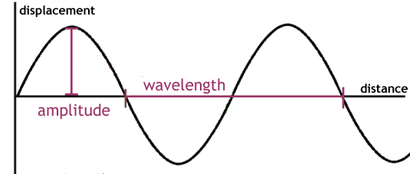
Waves
Progressive Wave:
A progressive wave is defined as the onward transmission of the vibratory motion of a body in an elastic medium from one particle to the successive particle.

Slide 6
Waves
Equation of a plane progressive wave
An equation can be formed to represent generally the displacement of a vibrating particle in a medium through which a wave passes. Thus each particle of a progressive wave executes simple harmonic motion of the same period and amplitude differing in phase from each other.
Let us assume that a progressive wave travels from the origin O along the positive direction of X axis, from left to right. The displacement of a particle at a given instant is
y = a sin ωt …... (1)
where a is the amplitude of the vibration of the particle and ω = 2πf
The displacement of the particle P at a distance x from O at a given instant is given by,
y = a sin (ωt - φ) …... (2)

Slide 7
Waves
If the two particles are separated by a distance λ, they will differ by a phase of 2π. Therefore, the phase φ of the particle P at a distance
x is φ = (2π/λ) x
y = a sin (ωt - 2πx/λ) …... (3)
Since ω = 2πf = 2π (v/λ), the equation is given by,
y = a sin [(2πvt/λ) - (2πx/λ)]
y = a sin 2π/λ (vt – x) …... (4)
Equation 4 is known as general progressive wave euation.
Since, ω = 2π/T, the equation (3) can also be written as,
y = a sin 2π (t/T – x/λ) …... (5)
If the wave travels in opposite direction, the equation becomes,
y = a sin 2π (t/T + x/λ) …... (6)

Slide 8
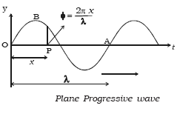
Waves

Slide 9
waves
(i) Variation of phase with time
The phase changes continuously with time at a constant distance.
At a given distance x from O let φ₁ and φ₂ be the phase of a particle at time t₁ and t₂ respectively.
φ₁ = 2π (t₁/T - x/λ)
φ₂ = 2π (t₂/T - x/λ)
φ₂ – φ₁ = 2π (t₂/T – t₁/T) = 2π/T (t₂ – t₁)
φ = (2π/T) t
This is the phase change φ of a particle in time interval t. If t = T, φ = 2π. This shows that after a time period T, the phase of a particle becomes the same.

Slide 10
Waves
(ii) Variation of phase with distance
At a given time t phase changes periodically with distance x. Let φ₁ and φ ₂ be the phase of two particles at distance x₁ and x₂ respectively from the origin at a time t.
Then, φ₁ = 2π (t/T - x₁/λ)
φ₂ = 2π (t/T - x₂/λ)
So, φ₂ – φ₁ = – 2π/λ (x₂ – x₁)
Thus, ?φ = – 2π/λ (?x)
The negative sign indicates that the forward points lag in phase when the wave travels from left to right.
When ?x = λ, ?φ = 2π, the phase difference between two particles having a path difference λ is 2π.

Slide 11
Waves
Characteristics of progressive wave
(a) Each particle of the medium executes vibration about its mean position. The disturbance progresses onward from one particle to another.
(b) The particles of the medium vibrate with same amplitude about their mean positions.
(c) Each successive particle of the medium performs a motion similar to that of its predecessor along the propagation of the wave, but later in time.
(d) The phase of every particle changes from 0 to 2π.
(e) No particle remains permanently at rest. Twice during each vibration, the particles are momentarily at rest at extreme positions, different particles attain the position at different time.

Slide 12
Waves
(f) Transverse progressive waves are characterized by crests and troughs. Longitudinal waves are characterized by compressions and rarefactions.
(g) There is a transfer of energy across the medium in the direction of propagation of progressive wave.
(h) All the particles have the same maximum velocity when they pass through the mean position.
(i) The displacement, velocity and acceleration of the particle separated by nλ are the same, where n is an integer.

Slide 13
Waves
Problem:
A simple harmonic wave of amplitudes 8 cm traverses a line in the positive direction of X-axis. At any instant of time for a particle of distance 25 cm from origin the displacement is 6 cm, and for a particle of distance 40 cm the displacement is 4 cm. Find the wavelength of the wave.

Slide 14
Waves
Resonance:
we defined resonance as a phenomenon in which a small-amplitude driving force could produce large-amplitude motion. In the case of standing waves, the relatively large amplitude standing waves are produced by the superposition of smaller amplitude component waves.
Standing Waves:
Two or more traveling waves of same amplitude and wavelength moving in opposite directions, the resultant amplitude being double or zero. The resultant looks like a wave standing in place and, thus, is called a standing wave.

Slide 15
Waves
Equation for standing/stationary waves:
Let a progressive wave move along positive X- axis. The equation of this wave
Y1 = A Sin 2π/λ (vt-x)
Along negative X-axis
Y2 = A Sin 2π/λ (vt+x)
Here, A₀ is the amplitude of the wave and y₁ and y₂ are the displacements of a particle of the wave at a distance x from the source at time t.

Slide 16
Waves
According to the principle of superposition, the resultant displacement of the particle
Y = Y₁ + Y₂
So, Y = A Sin 2π/λ (vt-x) + A Sin 2π/λ (vt+x)
Y = 2A Sin 2πvt/λ Cos 2πx/λ
[sin A + sin B = 2 Sin (A+B)/2 Cos (A-B)/2]
Y = Ao Sin 2πvt/λ [ Ao = 2A Cos 2πx/λ]
Or, Y = Ao Sin ωt, where, ω = 2πf, and v = fλ
This is the equation for stationary wave.

Slide 17
Waves
Progressive waves | Stationary waves
The disturbance produced in the medium travels onward, it being handed over from one particle to the next. Each particle executes the same type of vibration as the preceding one, though not at the same time. | There is no onward motion of the disturbance as no particle transfers its motion to the next. Each particle has its own characteristic vibration.
The amplitude of each particle is the same but the phase changes continuously, | The amplitudes of the different particles are different, ranging from zero at the nodes to maximum at the antinodes. All the particles in a given segment vibrate in phase but in opposite phase relative to the particles in the adjacent segment.
No particle is parmanently at rest. Different particles attain the state of momentary rest at different instants, | The particles at the nodes are permanently at rest but other particles attain their position of momentary rest simultaneously.

Slide 18
Waves
Progressive waves | Stationary waves
All the particles attain the same maximum velocity when they pass through their mean positions. | All the particles attain their own maximum velocity at the same time when they pass through their mean positions.
In the case of a longitudinal progressive wave all the parts of the medium undergo similar variation of density one after the other. At every point there will be a density variation. | In the case of a longitudinal stationary wave the variation of density is different at different points being maximum at the nodes and zero at the antinodes.
There is a flow of energy across every plane in the direction of propagation. | Energy is not transported across any plane.

Slide 19
Waves
Doppler effect:
The apparent difference between the frequency at which sound or light waves leave a source and that at which they reach an observer, caused by relative motion of the observer and the wave source.
So, Doppler effect in physics is defined as the increase (or decrease) in the frequency of sound, light, or other waves as the source and observer move towards (or away from) each other.

Slide 20
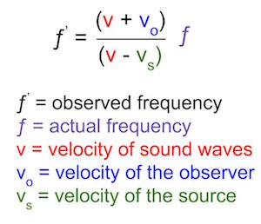
Waves Equation for Doppler effect

Slide 21
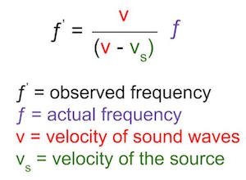
Waves
Source Moving Towards the Observer at Rest:
Imagine our ambulance again. In this scenario, you are standing still and the ambulance is moving towards you. Let's look back to our equation. The velocity of the observer is zero, so v_{o} is equal to zero. Plugging this into the equation above, we get the equation when a source is moving towards an observer at rest:
Equation for when a source moves towards an observer at rest

Slide 22
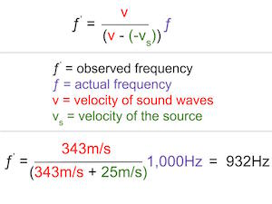
Waves
Source Moving Away from the Observer at Rest
Now, imagine the ambulance has passed you. The ambulance is traveling at 25m/s, but you are still stationary. The frequency of the sound emitted by the ambulance is 1,000Hz, and the sound waves travel with a velocity of 343m/s. Since your velocity is zero, we can eliminate v_{o} again from the equation. But this time, the ambulance is moving away from you, so its velocity is negative to indicate the direction. Inserting our numbers into the equation gets us:

Slide 23
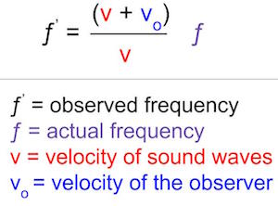
Waves
Observer Moving Toward a Stationary Source:
Now imagine riding in a car towards a loud block party. As you move towards the speakers, the sound waves get closer together and the frequency increases. In this case, you are moving, but the source is not. So, v_{s} will be equal to zero, and we get the following equation:

Slide 24
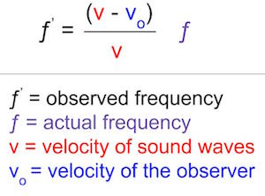
Waves
You pass the loud party and are on your way to a more serene setting. Now you're moving away from the sound waves, and the frequency decreases. So, since you're moving away, your velocity becomes negative. So, instead of adding v_{o}, we now subtract, since v_{o} is negative.

Slide 25
Waves
A driver in a car is traveling on a road next to railway tracks. When the train approaches, it blows the horn which generates a sound with a single frequency of 420.0 Hz. The driver is driving at the speed of 18.0 m/s and the train’s speed is 32.0 m/s. Further, the sound’s speed is 340.0 m/s. Calculate the frequency of the sound which the driver of the car will hear.
In order to find the frequency, we need to first establish a coordinate system. The positive direction is said to be from the listener to the source. The source is the horn of the train and thus the velocity of the train is negative while the velocity of the driver’s car is positive. The values known to us are v = 340.0 m/s , vL = +18.0 m/s, vs = -32.0 m/s and fs = 420.0 Hz.
Thus, we will arrange the value in the Doppler Effect Formula to find out the frequency which is:
F* = {(V+Vs)/(V+VL )}Fs

Slide 26
Waves
A bike rider approaching a vertical wall observes that the frequency of his bike horn changes from 440 Hz to 480 Hz when it gets reflected from the wall. Find the speed of the bike if the speed of sound is 330 m/s. Solution: Let the bike approach the wall with a speed u. Then the apparent frequency received by the wall can be calculated as F = Fo {V/(V-U)} For reflected wave, F* = F {(V+U)/V} Substituting (1) in (2), we get F* = {(V+U)/(V-U)}Fo U = Bike Speed and V = Sound Speed

